Slide 1
Session – 11
Extreme Programming

Slide 2
Extreme Programming
Extreme Programming (XP) is a well-known agile method; it emphasizes collaboration, quick and early software creation, and skillful development practices.

Slide 3
Extreme Programming
XP founded on four values:
communication, simplicity, feedback, and courage.
In addition to IID, it recommends 12 core practices:
1. Planning Game 7. pair programming
2. small, frequent releases 8. team code ownership
3. system metaphors 9. continuous integration
4. simple design 10. sustainable pace
5. testing 11. whole team together
6. frequent refactoring 12. coding standards

Slide 4
Extreme Programming (XP) Model
XP Planning
  Begins with the creation of “user stories”
  Agile team assesses each story and assigns a cost
  Stories are grouped to for a deliverable increment
  A commitment is made on delivery date
  After the first increment “project velocity” is used to help define subsequent delivery dates for other increments

Slide 5
Extreme Programming (XP)
XP Design
  Follows the KISS(Keep it Simple, Stupid) principle
  Encourage the use of CRC cards (Class Responsibility Collaboration)
  For difficult design problems, suggests the creation of “spike solutions”—a design prototype( A Working Model)
  Encourages “refactoring”—an iterative refinement of the internal program design
XP Coding
  Recommends the construction of a unit test for a store before coding commences
  Encourages “pair programming”
XP Testing
  All unit tests are executed daily
  “Acceptance tests” are defined by the customer and executed to assess customer visible functionality

Slide 6

Extreme Programming (XP)

Slide 7
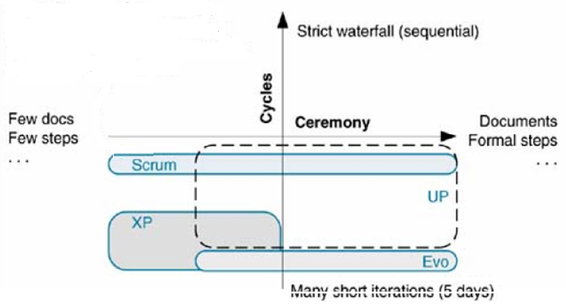
Extreme Programming (XP)
Method Overview

Slide 8
Work products Roles and Practices
Work Products (Non Software):
-Requirements – Story Cards
-Design- CRC Cards, Sketches
-Project Management- Task list, Visible graphs
Roles:
-Custumer
-Development
-Management
-Other
Practices:
-Requirements
-Design
-Implementation
-Test and Verification
-Project Management
-Configuration & Change management environment

Slide 9
Questions
List out Core practices in Extreme Programming.
Explain Extreme programming Life cycle.
Illustrate XP Work products Roles and Practices for safe home application.
Write extreme programming advantages and disadvantages?
How User requirements are expressed in Extreme Programming.

